Slide 1
Pointers (CS 1004)
Department of Computer Science,
National University of Computer & Emerging Sciences, Islamabad Campus

Slide 2
From C++ Code to Process
C++ source files
.cpp; .h
Binary files
.o
Executable (linux, Ubuntu, …)
a.out
Process
Managed by OS
C++ source code
compiling
binary files
linking
executable
running
process

Slide 3
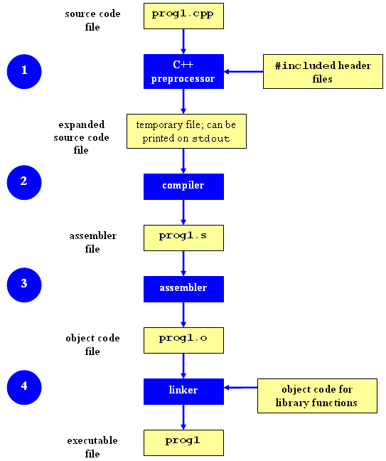

Slide 4
C++ Memory Models
C++ leaves memory management mostly up to the programmer:
ve++: write programs that use memory very efficiently
Ve--: write programs that waste memory or do not work at all
For efficient program working, we need good understanding of the memory models

Slide 5
C++ Memory Models
Common errors caused by poor memory management:
Using a variable before it has been initialized
Allocating memory for storage and not deleting it
Using a value after it has been deleted
What are the solutions?
….

Slide 6
Main Memory
Network
Audio
CPU
Data Bus
Disk
Video
Memory
shared by all processes

Slide 7
Virtual Memory (How a CPU see’s a Process?)
Continuous memory space for all process:
Set of locations as needed by a process
0
0xffffffff

Slide 8
Organization of Virtual Memory: .text
Program code and constant
binary form
loaded libraries
code instructions
space calculated at compile-time
0
text
0xffffffff

Slide 9
Organization of Virtual Memory: .data
Data: initialized global data in the program
Ex: int size = 100;
BSS: un-initialized global data in the program
Ex: int length;
0
text
data
bss
0xffffffff
Notes:
BSS: Better Save Space

Slide 10
Organization of Virtual Memory: heap
Heap: dynamically-allocated spaces
Ex: new, delete
dynamically grows as program runs
0
text
data
bss
heap
0xffffffff

Slide 11
Organization of Virtual Memory: stack
Stack: local variables in functions
support function call/return and recursive functions
grow to low address
0
text
data
bss
heap
0xffffffff
stack

Slide 12
Summary: Process Address Space
text: program text/code
data: initialized globals & static data
bss: un-initialized globals & static data
heap: dynamically managed memory
stack: function’s local variables
0
text
data
bss
heap
0xffffffff
stack

Slide 13
Introduction to Pointers
When we declare a variable, some memory is allocated for it.
Thus, we have two properties for any variable:
Its Address
and its Data value
E.g., char ch = ‘A’;
Memory Address
Value
ch
311
65

Slide 14
Introduction to Pointers
How to get the memory-address of a variable?
Address of a variable can be accessed through the referencing operator “&”
Example: &i ➔ will return memory location where the data value for “i” is stored.
A pointer is a variable, that stores an address.

Slide 15
Introduction to Pointers
We can declare pointers as follows:
Type* <variable Name>;
Example:
int* P;
- creates a pointer variable named “P”, that will store address (memory location) of some int type variable.

Slide 16
The address of Operator &
The & operator can be used to determine the address of a variable, which can be assigned to a pointer variable
Examples:
Notes:
int* p1;
int v1=99;
p1 = &v1;
Now p1 points to the memory location,
where v1 is stored.
- v1 is an integer variable
- P1 is a integer pointer

Slide 17
Dereferencing Operator *
C++ uses the * operator in yet another way with pointers
"The variable values pointed to by p" → *p
Here the * is the dereferencing operator
p is said to be dereferenced
int v1=99;
int* p= &v1;
cout<<“ P points to the value: “<<*p;

Slide 18
Dereferencing Pointer Example
int v1 = 0; int* p1 = &v1; *p1 = 42; cout << v1 << endl; cout << *p1 << endl;
v1 and *p1 now refer to the same variable
Output:
42
42

Slide 19
Pointer Assignment and Dereferencing
Assignment operator ( = ) is used to assign value of one pointer to another
Pointer stores addresses so p1=p2 copies an address value into another pointer
int v1 = 55; int* p1 = &v1; int* p2;
p2=p1; cout << *p1 << endl; cout << *p2 << endl;
Output:
55
55

Slide 20
Example
char *string = “hello”;
const int iSize=8;
char* f(int x)
{
char *p;
p = new char[iSize];
return p;
}
0
text
data
bss
heap
0xffffffff
stack

Slide 21
Example
char *string = “hello”;
const int iSize=8;
char* f(int x)
{
char *p;
p = new char[iSize];
return p;
}
0
text
data
bss
heap
0xffffffff
stack

Slide 22
Variable Lifetime
text:
program startup
program finish
data, bss:
program startup
program finish
heap:
dynamically allocated
de-allocated (free)
stack:
function call
function return
0
text
data
bss
heap
0xffffffff
stack

Slide 23
Example
char *string = “hello”;
const int iSize=8;
char *f (int x)
{
char *p;
p = new char[iSize];
return p;
}
program startup
0
text
data
bss
when f() is called
heap
live after allocation; till delete or program finish
0xffffffff
stack

Slide 24
Variable Initialization
text:
Read-only (once; e.g., constants)
data
on program startup
bss:
un-initialized (though some systems initialize with 0)
heap:
un-initialized
stack:
un-initialized
0
text
data
bss
heap
0xffffffff
stack

Slide 25
Dynamic Memory Allocation
Used when space requirements are unknown at compile time
Most of the time the amount of space required is unknown at compile time
Dynamic Memory Allocation (DMA):-
With Dynamic memory allocation we can allocate/deletes memory (elements of an array) at runtime or execution time.

Slide 26
Differences between Static and Dynamic Memory Allocation
Dynamically allocated memory is kept on the memory heap (also known as the free store)
Dynamically allocated memory cannot have a "name", it must be referred to
Declarations are used to statically allocate memory,
the new operator is used to dynamically allocate memory

Slide 27
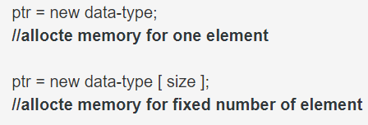
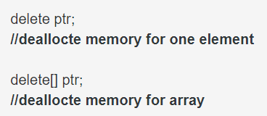
Dynamic Memory Allocation
Heap management in C++ is explicit:

Slide 28
Example
int main()
{
int *p;
p = new int;
return 0;
}
0
text
data
bss
heap
p
0xffffffff
stack

Slide 29
Example
int main()
{
int *p;
p = new int;
return 0;
}
0
text
data
bss
heap
#@%*&
p
0xffffffff
stack

Slide 30
Example
int main()
{
int *p;
p = new int;
*p = 99;
return 0;
}
0
text
data
bss
heap
99
p
0xffffffff
stack

Slide 31
Aliasing
int main()
{
int *p, *q;
p = new int;
*p = 99;
q = p;
return 0;
}
0
text
data
bss
heap
99
q
p
0xffffffff
stack

Slide 32
Aliasing
int main()
{
int *p, *q;
p = new int;
*p = 99;
q = p;
*q = 88;
return 0;
}
0
text
data
bss
heap
88
q
p
0xffffffff
stack

Slide 33
Aliasing
int main()
{
int *p, *q;
p = new int;
*p = 99;
q = p;
*q = 88;
delete q;
return 0;
}
0
text
data
bss
heap
$%#^&
q
p
0xffffffff
stack
Notes:
P and q still points to the same memory location (that may have same or different value)

Slide 34
Dangling Pointers
int main()
{
int *p, *q;
p = new int;
*p = 99;
q = p;
*q = 88;
delete q;
*p = 77;
return 0;
}
0
text
P and q are dangling pointers
WHY?
data
bss
heap
$%#^&
q
p
0xffffffff
stack
Notes:
P and q→ don't point to a valid allocated memory.

Slide 35
Dangling Pointers
The delete operator does not delete the pointer, it takes the memory being pointed to and returns it to the heap
It does not even change the contents of the pointer
Since the memory being pointed to is no longer available (and may even be given to another application), such a pointer is said to be dangling

Slide 36
Avoiding a Dangling Pointer
For Variables:
delete v1;
v1 = NULL;
For Arrays:
delete[ ] arr;
arr = NULL;

Slide 37
Returning Memory to the Heap
Remember:
Return memory to the heap before undangling the pointer
What's Wrong with the Following:
ptr = NULL;
delete ptr;

Slide 38
Memory Leaking
int main()
{
int *p;
p = new int;
// make the above space unreachable; How?
p = new int;
// even worse…; WHY?
while (1)
p = new int;
return 0;
}

Slide 39
Memory Leaking
void f ( )
{
int *p;
p = new int;
return;
}
int main ( )
{
f ( );
return 0;
}

Slide 40
Memory Leaks
Memory leaks when it is allocated from the heap using the new operator but not returned to the heap using the delete operator

Slide 41
Memory Leaking and Dangling Pointers
Dangling pointers and memory leaking are evil sources of bugs:
hard to debug
may appear after a long time of run
may far from the bug point
hard to prevent
What should be the good programming practices while using Pointers?

Slide 42
Pointers Data-Type
Question:
Why is it important to declare the type of the variable that a pointer points to?
Aren’t all memory addresses of the same length?

Slide 43
Pointers Type
Answer:
- All memory addresses are of the same length,
However, with operation “p++” where “p” is a pointer → the compiler needs to know the data type of the variable “p” (to jump at next memory location)
Examples:
If “p” is a character-pointer then “p++” will increment “p” by one byte (next location)
if “p” is an integer-pointer its value on “p++” would be incremented by 4 bytes (next loc.)

Slide 44
Pointers Types
Summary:
Pointer is a data-type that stores addresses, it is declared as follows: int* a; char* p; etc.
The value stored in a pointer p can be accessed through the dereferencing operator *
The address of a memory location of a variable can be accessed through the reference operator “&”.

Slide 45
Pointer Assignments (Aliasing)
Some care is required making assignments to pointer variables:
p1= p2; // changes the location that p1 "points" to
*p1 = *p2; // changes the value at location that // p1 "points" to

Slide 46
Another Pointer Example
int i = 1;
int j = 2;
int* ptr;
ptr = &i; // ptr points to location of i
*ptr = 3; // contents of i are updated
ptr = &j; // ptr points to location of j
*ptr = 4; // contents of j are updated
cout << i << " " << j << endl;
Output:
3
4

Slide 47
Null Address
Like a local variable, a pointer is assigned a random value (i.e., address) if not initialized
0 is a pointer constant that represents the empty or Null address
Should be used to avoid dangling pointers
Cannot Dereference a Pointer whose value is Null:
int *ptr = 0; OR int *ptr=NULL;
cout << *ptr << endl; // ERROR: ptr
// does not point to
// a valid address

Slide 48
Relationship Between Pointers and Arrays
Arrays and pointers are closely related
Array name is like constant pointer
All arrays elements are placed in the consecutive locations.
Example:- int List [10]; List is the start address of array
Pointers can do array subscripting operations We can access array elements using pointers.
Example:- int value = List [2]; //value assignment
int* p = List; //address assignment

Slide 49
Relationship Between Pointers and Arrays (Cont.)
Effect:-
- List is an address, no need for &
- The bPtr pointer will contain the address of the first element of array List.
Element List[2] can be accessed by *( bPtr + 2 )

Slide 50
Relationship between Arrays and Pointers
Arrays and pointers are closely related:
void main()
{
int numbers[]={10,20,30,40,50};
cout<<numbers[0]<<endl;
cout<<numbers<<endl;
cout<<*numbers<<endl;
cout<<*(numbers+1);
}
10
Address e.g., &34234
10
20

Slide 51
Arrays and Pointers
Array name is the starting address of the array
Let int A[25]; int *p; int i, j;
Let p = A;
Then p points to A[0] p + i points to A[i] &A[j] == p+j *(p+j) is the same as A[j]

Slide 52
Arrays and Pointers

Slide 53
Pointer Arithmetic
Only two types of arithmetic operations allowed:
Addition : only integers can be added
Subtraction: only integers be subtracted
Which of the following are valid/invalid?

Slide 54
Comparing Pointers
If one address comes before another address in memory, the first address is considered less than the second address.
Two pointer variables can be compared using C++ relational operators: <, >, <=, >=, ==
In an array, elements are stored in consecutive memory locations, E.g., address of Arr[2] will be smaller than the address of Arr[3] etc.
Notes:
When you subtract two pointers, as long as they point into the same array, the result is the number of elements separating them.

Slide 55
Void Pointer
void* is a pointer to no type at all:
Any pointer type may be assigned to void *
int iVar=5;
float fVar=4.3;
char cVar=‘Z’;
int* p1;
void* vp2;
p1 = &iVar; // Allowed
p1 = &fvar; // Not Allowed
P1 = &cVar; // Not Allowed
vp2 = &fvar; // Allowed
vp2 = &cVar; // Allowed
vp2 = &iVar; // Allowed
This is a great advantage…
So, What are the limitations/challenges?

Slide 56
Accessing 1-Demensional Array Using Pointers
We know, Array name denotes the memory address of its first slot.
Example:
int List [ 50 ];
int *Pointer;
Pointer = List;
Other slots of the Array (List [50]) can be accessed using by performing Arithmetic operations on Pointer.
For example the address of (element 4th) can be accessed using:-
int *Value = Pointer + 3;
The value of (element 4th) can be accessed using:-
int Value = *(Pointer + 3);
Address
Data
980
Element 0
982
Element 1
984
Element 2
986
Element 3
988
Element 4
990
Element 5
992
Element 6
994
Element 7
996
Element 8
…
…
998
Element 49

Slide 57
Accessing 1-Demensional Array
Address
Data
….
….
int List [ 50 ];
int *Pointer;
Pointer = List; // Address of first Element
int *ptr;
ptr = Pointer + 3; // Address of 4th Element
*ptr = 293; // 293 value store at 4th element address
}
980
Element 0
982
Element 1
984
Element 2
Element 3
986
293
986
988
Element 4
990
Element 5
992
Element 6
994
Element 7
996
Element 8
…
…
998
Element 49

Slide 58
Accessing 1-Demensional Array
We can access all element of List [50] using Pointers and for loop combinations.
Address
Data
…
…
int List [ 50 ];
int *Pointer;
Pointer = List;
for ( int i = 0; i < 50; i++ )
{
cout << *Pointer;
Pointer++; // Address of next element
}
980
Element 0
982
Element 1
984
Element 2
986
Element 3
988
Element 4
990
Element 5
992
Element 6
994
Element 7
996
Element 8
…
…
998
Element 49
This is Equivalent to
for ( int loop = 0; loop < 50; loop++ )
cout << Array [ loop ] ;

Slide 59
Accessing 2-Demensional Array
Note that the statements
int *Pointer;
Pointer = &List [3];
represents that we are accessing the address of 4th slot.
In 2-Demensional array the statements
int List[ 5 ][ 6 ];
int *Pointer;
Pointer = &List [3];
Represents that we are accessing the address of 4th row
or the address the 4th row and 1st column.
Address
Data
980
Element 0
982
Element 1
984
Element 2
986
Element 3
988
Element 4
990
Element 5
992
Element 6
994
Element 7
996
Element 8
…
…
998
Element 50

Slide 60
Accessing 2-Demensional Array
int List [ 9 ] [ 6 ];
int *ptr;
ptr = &List [3];
To access the address of 4th row 2nd column:
ptr++; // address of 4th row 2nd column
(faster than normal array accessing Why?)
Equivalent to List [3][1] ;
Column
0
1
2
3
4
5
0
300
302
304
306
308
310
1
312
314
316
318
320
322
2
324
326
328
330
332
334
3
336
338
340
342
344
346
Row
4
348
350
352
354
356
358
5
360
362
364
366
368
370
6
372
374
376
378
380
382
7
384
386
388
390
392
394
8
396
398
400
402
404
406
Memory address

Slide 61
Accessing 2-Demensional Array
We know computer can perform only one operation at any time (remember fetch-decode-execute cycle).
Thus to access List [3][1] element (without pointer) two operations are involved:-
First to determine row List [3]
Second to determine column List[3][1]
But using pointer we can reach the element of 4th row 2nd column (directly) by increment our pointer value (which is a single operation).
ptr+1; // 4th row 2nd column
ptr+2; // 4th row 3rd column
ptr+3; // 4th row 4th column
Column
0
1
2
3
4
5
0
300
302
304
306
308
310
1
312
314
316
318
320
322
2
324
326
328
330
332
334
3
336
338
340
342
344
346
Row
4
348
350
352
354
356
358
5
360
362
364
366
368
370
6
372
374
376
378
380
382
7
384
386
388
390
392
394
8
396
398
400
402
404
406
Memory address

Slide 62
Swapping variables using Pointers
void main() {
char a = ‘A';
char b = ‘Z';
char *Ptr1= &a;
char *Ptr2= &b;
char temp = *Ptr1;
*Ptr1 = *Ptr2;
*Ptr2 = c;
cout << a << b << endl;
}
;

Slide 63
Dynamic Memory Allocation
Used when space requirements are unknown at compile time
Most of the time the amount of space required is unknown at compile time
Dynamic Memory Allocation (DMA):-
With Dynamic memory allocation we can allocate/deletes memory (elements of an array) at runtime or execution time.

Slide 64
Differences between Static and Dynamic Memory Allocation
Dynamically allocated memory is kept on the memory heap (also known as the free store)
Dynamically allocated memory cannot have a "name", it must be referred to
Declarations are used to statically allocate memory,
the new operator is used to dynamically allocate memory

Slide 65
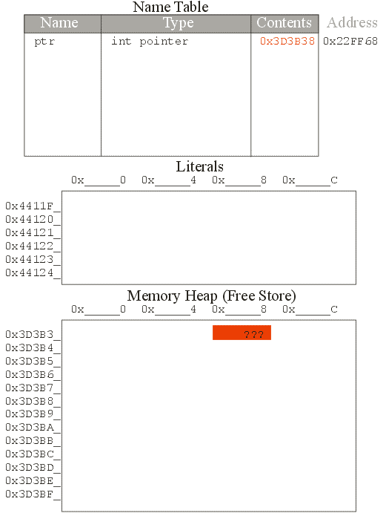
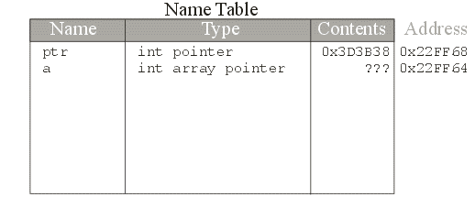
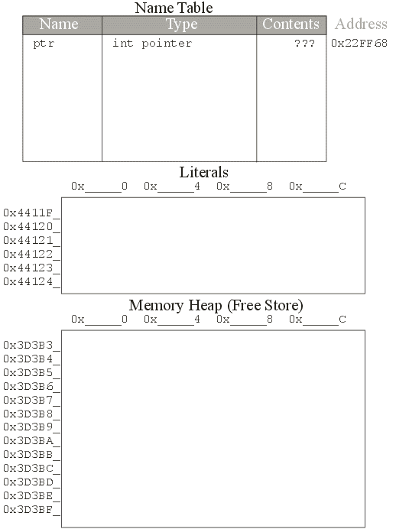
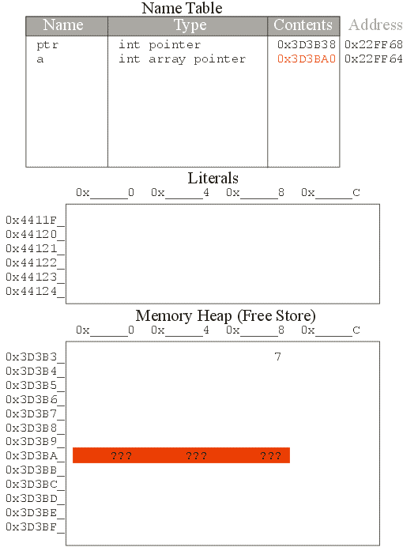
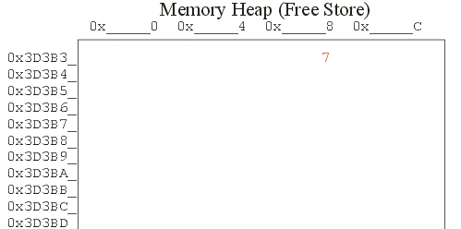
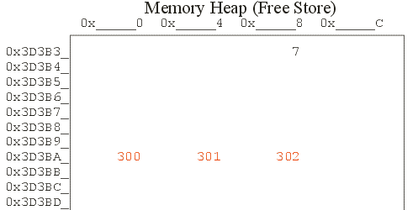
Pointing to Memory Allocated at Run Time
int *ptr;
ptr = new int;
*ptr = 7;
int *a;
a = new int[3];
*a = 300;
*(a+1) = 301;
*(a+2) = 302;

Slide 66
Returning Memory to the Heap
How Big is the Heap?
Most applications request memory from the heap when they are running;
It is possible to run out of memory (you may even have gotten a message like "Running Low On Virtual Memory")
So, it is important to return memory to the heap when you no longer need it

Slide 67
Returning Memory to the Heap
The Opposite of new:
The delete operator in C++

Slide 68
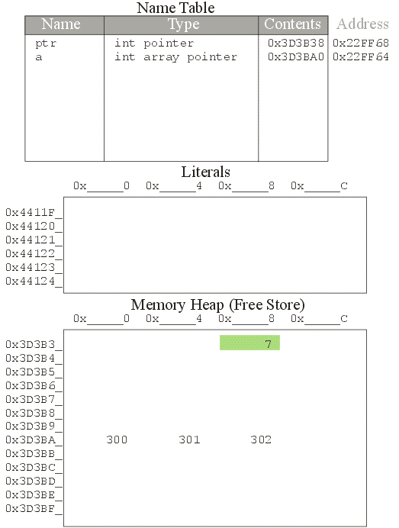
delete ptr;

Slide 69
Dangling Pointers
The delete operator does not delete the pointer, it takes the memory being pointed to and returns it to the heap
It does not even change the contents of the pointer
Since the memory being pointed to is no longer available (and may even be given to another application), such a pointer is said to be dangling

Slide 70
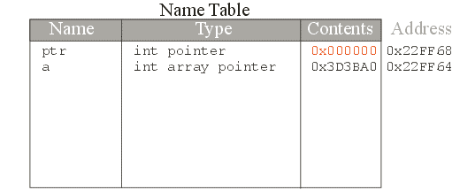
ptr = NULL;

Slide 71
Returning Memory to the Heap
Remember:
Return memory to the heap before undangling the pointer
What's Wrong with the Following:
ptr = NULL;
delete ptr;

Slide 72
Returning Memory to the Heap
For Arrays:
delete[ ] a;
a = NULL;

Slide 73
Memory Leaks
Memory leaks when it is allocated from the heap using the new operator but not returned to the heap using the delete operator

Slide 74
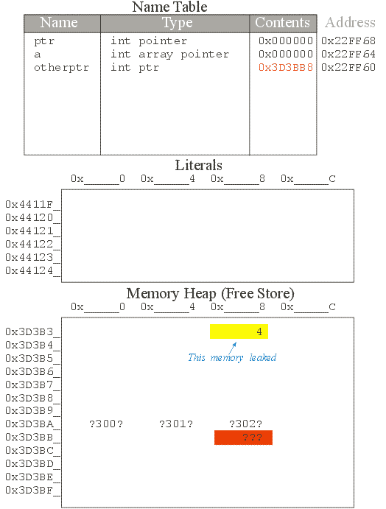
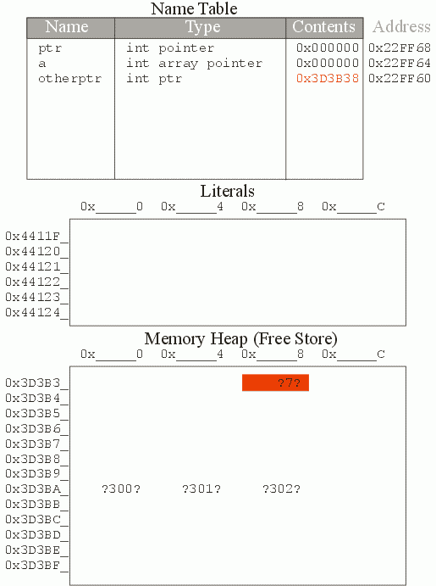
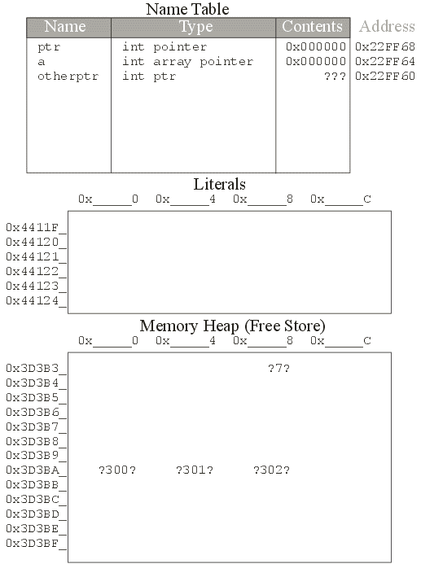
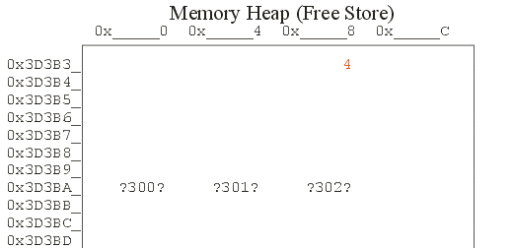
int *otherptr;
otherptr = new int;
*otherptr = 4;
otherptr = new int;

Slide 75
Casting pointers
Pointers have types, so you cannot just do
int *pi; double *pd;
pd = pi;
Even though they are both just integers, C++ not allows (Error)

Slide 76
Casting pointers
C++ will let you change the type of a pointer with an explicit cast
int *pi; double *pd;
pd = (double*) pi;
Note: Values differenced after cast are undermined (difference of memory size)
Notes:
int *ip; char* cp; double *dp;

Slide 77
Creating Dynamic 2D Arrays
Two basic methods:
Using a single Pointer
Using a Array of Pointers

Slide 78
Dynamic two dimensional arrays
Using a single Pointer
Total elements in a 2D Array:
m * n (i.e., rows * cols)
5 rows * 4 columns = 20 elements
Target Approach=
allocate 20 elements using dynamic allocation
Use a single pointer to point and access those items.

Slide 79
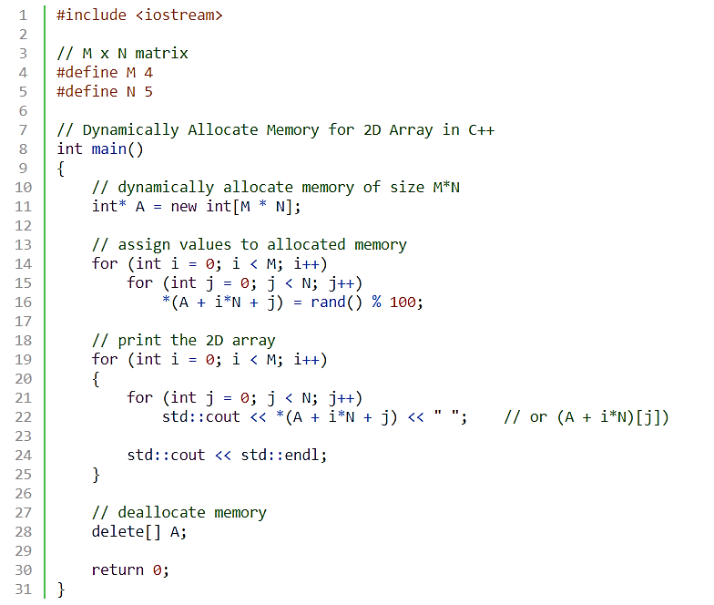
Dynamic 2D Arrays
Notes:
int main(){
int *p= new int[5];
for(int i =0; i<5;i++)
cin>>*(p+i);
for(int i =0; i<5;i++)
cout<<" "<<p[i];
return 0;}

Slide 80
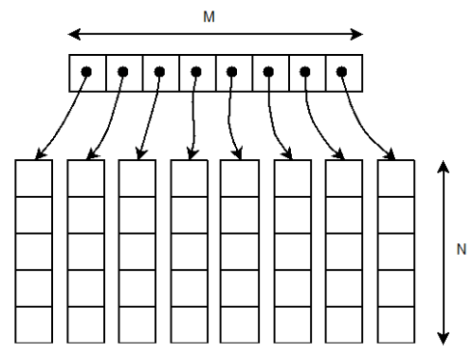
Dynamic 2D Array – Double Pointer
Using a Pointer that points to Array of Pointer
Total elements in a 2D Array: M_rows * N_coulmns
Ptr2D
(Pointer to a Pointer)

Slide 81
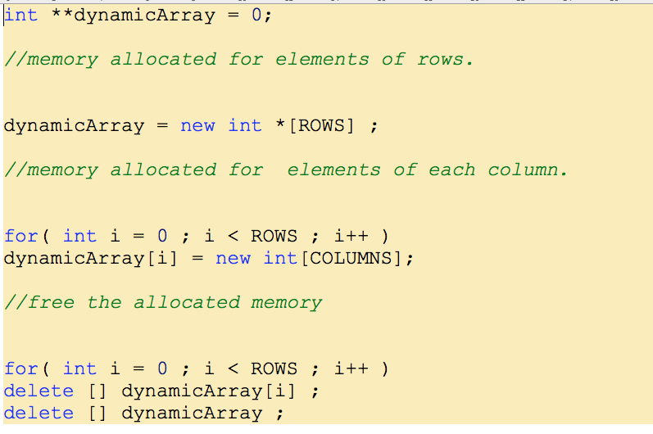
Dynamic 2D Array – Double Pointer
Notes:
The bracket operator is implemented by computing the address of the ith object
base = A = address of A[0] address of element i = base + offset = base + i * sizeof(T) A[i] = reference to element at this address Pointer must know its type to compute addresses using sizeof(T)
Note carefully the distinction between A and A[0]

Slide 82
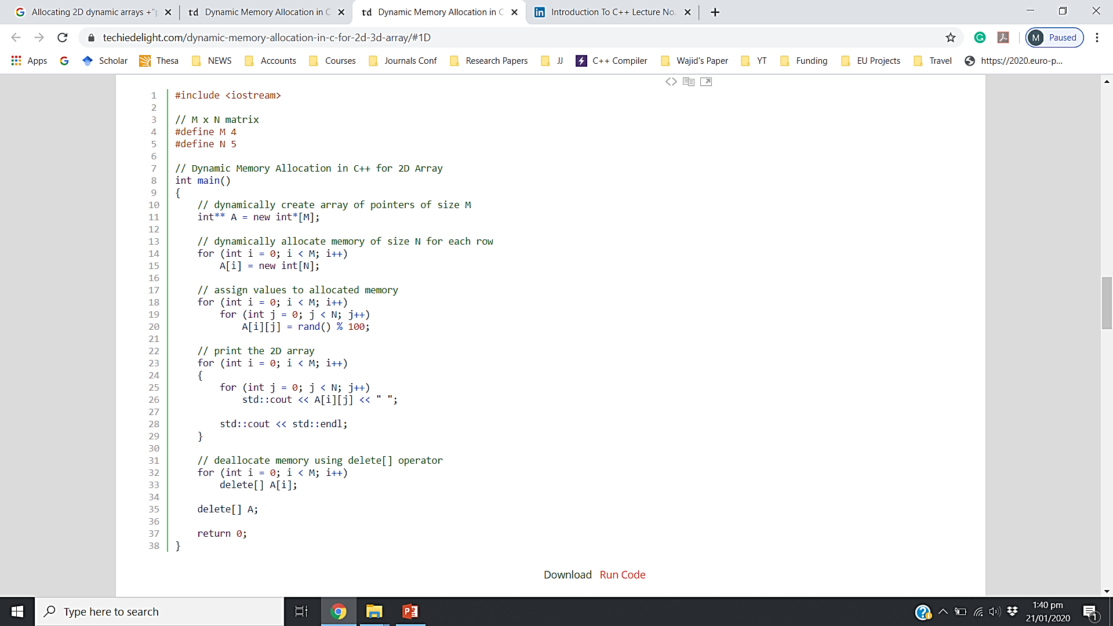
Dynamic two dimensional arrays
Can we vary size of each column in Dynamic 2D Array (using double pointer)
PP → start of array of pointers
*PP → First Address pointed by first row (sub array)
*(*PP) → First value of first array
(*PP)++ → Move to next address in the first array
PP++ → Move to Next row (second array address
Notes:
Access using a single pointer:
*pp → start of array of pointers

Slide 83
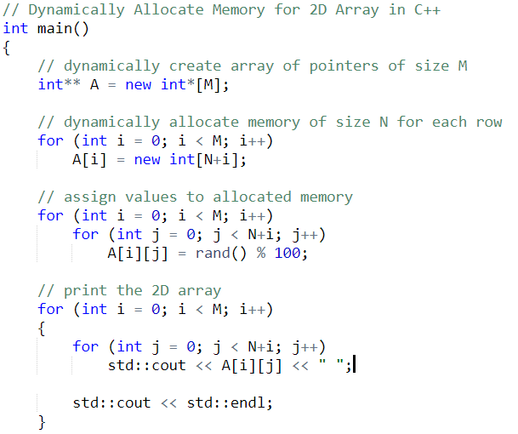
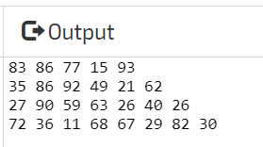
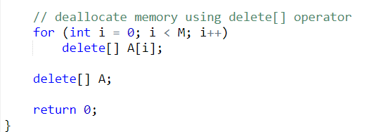
Dynamic 2D Array (Varying Row Size)

Slide 84
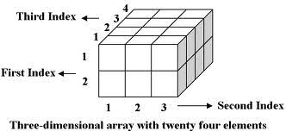
Home Work
- Manipulating a 3D Array
Using a single pointer
Using a triple pointer

Slide 85
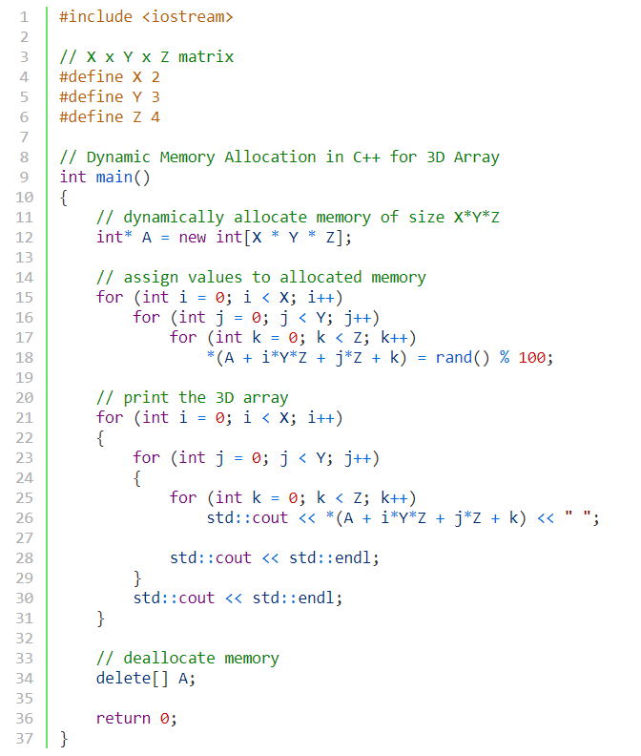
3D Array Using a single pointer

Slide 86
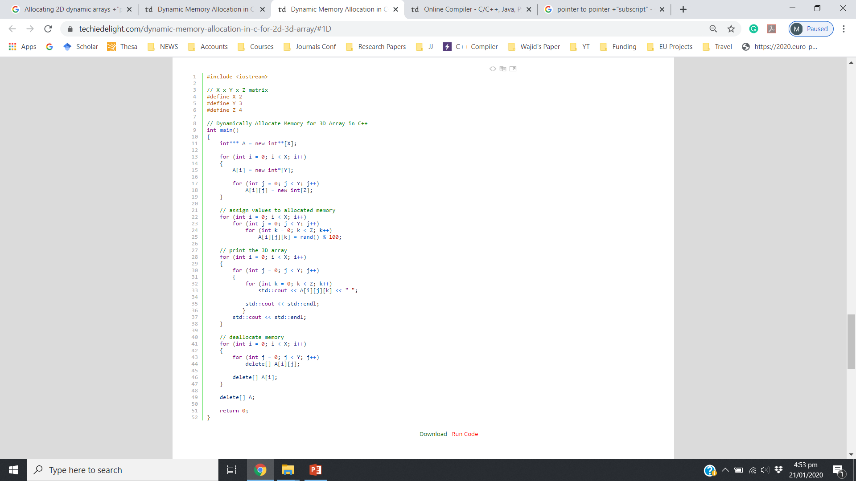
3D Array Using a triple pointer

Slide 87
Constant Pointer
A constant pointer is a pointer that is constant, such that we cannot change the location (address) to which the pointer points to:
char c = 'c';
char d = 'd';
char* const ptr1 = &c;
ptr1 = &d; // Not Allowed
int* const ptrInt=&v1; //ptr is constant pointer to int

Slide 88
Pointer to Constant 1/2
we cannot set a non-const pointer to a const data-item
const int value = 5; // value is const
int *ptr = &value; // compile error: cannot convert const int* to int*
*ptr = 6; // change value to 6
const int value = 5;
const int *ptr = &value; // this is okay,
*ptr = 6; // not allowed, we cannot change a const value

Slide 89
Pointer to Constant 2/2
A pointer through which we cannot change the value of variable it points is known as a pointer to constant.
These type of pointers can change the address they point to but cannot change the value kept at those address.
int var1 = 0;
const int* ptr = &var1;
*ptr = 1; // Not Allowed
cout<<*ptr;

Slide 90
char* and const
const char *ptr : This is a pointer to a constant character. You cannot change the value pointed by ptr, but you can change the pointer itself. “const char *” is a (non-const) pointer to a const char.
char *const ptr : This is a constant pointer to non-constant character. You cannot change the pointer p, but can change the value pointed by ptr.
const char * const ptr : This is a constant pointer to constant character. You can neither change the value pointed by ptr nor the pointer ptr.

Slide 91
C-String and Char Pointer
A String: is simply defined as an array of characters
char* s; // s is the address of the first character (byte) of the string
A valid C string ends with the null character ‘\0’
Direct initialization char* <string Literal>;
char* s=“FAST”;
cout<<s<<sizeof(s);
cout<<++s<<sizeof(s);
Notes:
Output:
FAST
8 //64-bit machine
AST
8 //64-bit machine

Slide 92
char [ ] VS. char *
char A[20]=“FAST”; char* P=“FAST”;
A is an Array
A++; //invalid
sizeof(A) → 20 Characters or bytes
A and &A points to same memory
address
5) A=“PAKISTAN”; //invalid
A is an address, “PAKISTAN” is the start address where “PAKISTAN” string is stored in memory.
6) A[0]=‘p’; //Valid
7) A is stored in stack
P is a pointer variable
P++; //Valid
Sizeof(P) → 8 bytes
P points to start address where characters are stored, and &P points to address of pointer variable.
P=“PAKISTAN” //valid
P[0]=‘p’; //inValid
P is stored in Stack, “FAST” is stored in “Text” section (Read-only)
Notes:
Output:
FAST
8 //64-bit machine
AST
8 //64-bit machine

Slide 93
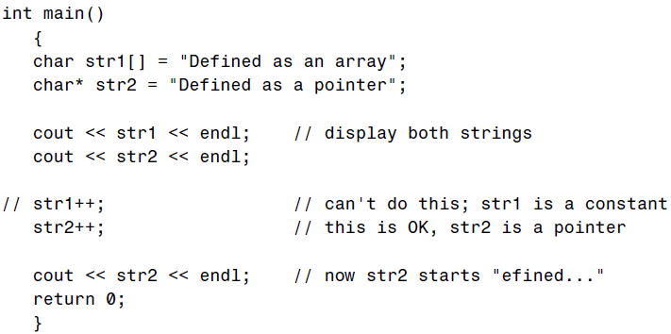
C-String and Char Pointer

Slide 94
C-String and Char Pointer - Example
// Copying string using Pointers
char* str1 = “Self-conquest is the greatest victory.”;
char str2[80]; //empty string
char* src = str1;
char* dest = str2;
while( *src ) //until null character,
*dest++ = *src++; //copy chars from src to dest
*dest = ‘\0’; //terminate dest
cout << str2 << endl; //display str2
Notes:
ASCII of NULL character or ‘\0’ is → 0

Slide 95
Functions→ Pass by using Reference Pointer
c
Pass-by-reference with pointer arguments
Use pointers as formal parameters and addresses as actual parameters
Pass address of argument using & operator
Arrays not passed with & because array name already an address
Pointers variable are used inside function

Slide 96
Pass by Reference Pointers– Example1
c
void func(int *num) { cout<<"num = "<<*num<<endl; *num = 10; cout<<"num = "<<*num<<endl; } void main() { int n = 5; cout<<"Before call: n = "<<n<<endl; func(&n); cout<<"After call: n = "<<n<<endl; }

Slide 97
Pass by Reference Pointers– Example2
c
void compDouble(int* Ar)
{ for(int i=0;i<10;i++)
{ *Ar=(*Ar)*2;
Ar++;
}
}
void main()
{ int Arr[10]={0,1,2,3,4,5,6,7,8,9};
compDouble(Arr);
for(int i=0;i<10;i++)
cout<<Arr[i]<<endl;
}

Slide 98
Pass by Reference Pointers– Example2
c
void compDouble(int* Ar)
{ for(int i=0;i<10;i++)
{ *Ar=(*Ar)*2;
Ar++;
}
}
void main()
{ int Arr[10]={0,1,2,3,4,5,6,7,8,9};
compDouble(Arr);
for(int i=0;i<10;i++)
cout<<Arr[i]<<endl;
}

Slide 99
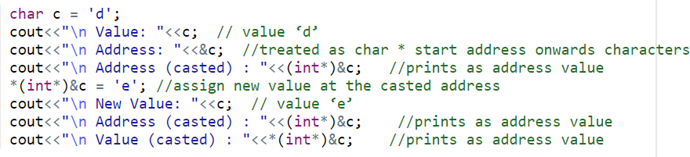
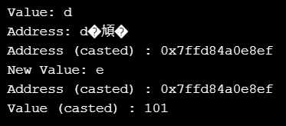
Questions (last lecture)
c
Address of character variable…
Notes:
int main (){ char c = 'd'; cout<<"\n Value: "<<c; // value ‘d’ cout<<"\n Address: "<<&c; //treated as char * start address onwards characters cout<<"\n Address (casted) : "<<(int*)&c; //prints as address value *(int*)&c = 'e'; //assign new value at the casted address cout<<"\n New Value: "<<c; // value ‘e’ cout<<"\n Address (casted) : "<<(int*)&c; //prints as address value cout<<"\n Value (casted) : "<<*(int*)&c; //prints as address value return 0;}

Slide 100
c
EXTRA Slides

Slide 101
c
Reference Variable and a Pointer
The main difference between C++ Reference vs Pointer is that one is referring to another variable while the latter is storing the address of a variable. ... An array of pointers can be created while an array of references cannot be created. A null value cannot be assigned to a reference but it can be assigned to a pointer.

Slide 102
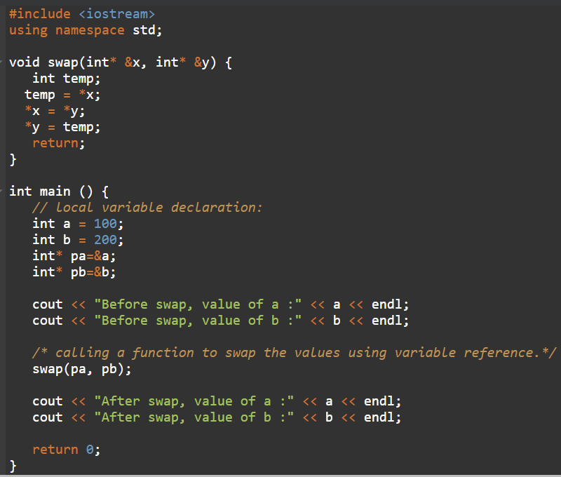
c
Passing a Pointer as a reference variable;

